Slide 1


Datathon 2023
Short-Term Rental Investment Strategy: Analysis, Planning, and Implementation
Team Synergy
1/20

Slide 2


Agenda
1 | Introduction | 5 | Revenue Projections
2 | Neighborhood Analysis | 6 | Technology Solutions
3 | Investment Strategy | 7 | Neighborhood Differentiation
4 | Recoupment Plan | 8 | Conclusion
2/20

Slide 3

Metrics
1
2
Annual SQFT
Net Operating Income
Rent over Price
Measures the pretax net profit per square feet
Measures the return by annual rental income per dollar
3/20

Slide 4
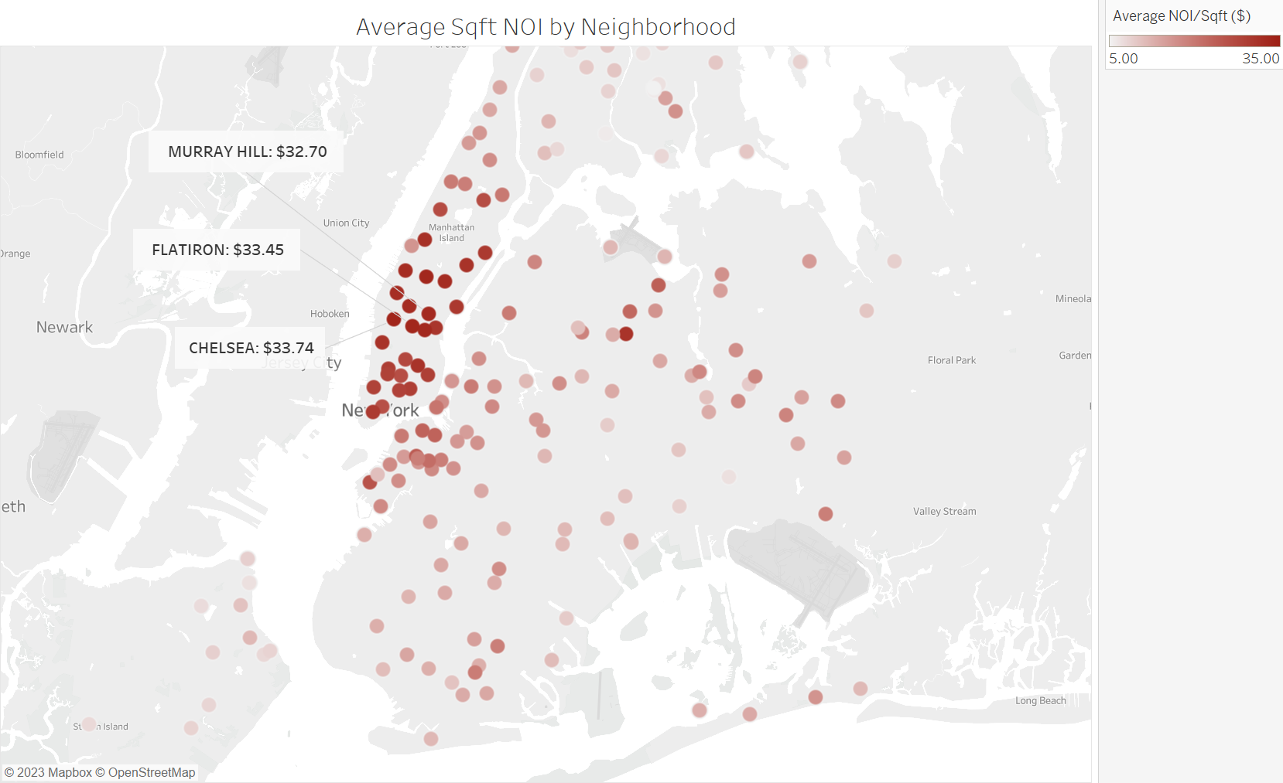
4/20
Notes:
title:
Average Square Feet NOI by Neighborhood
format: centered

Slide 5
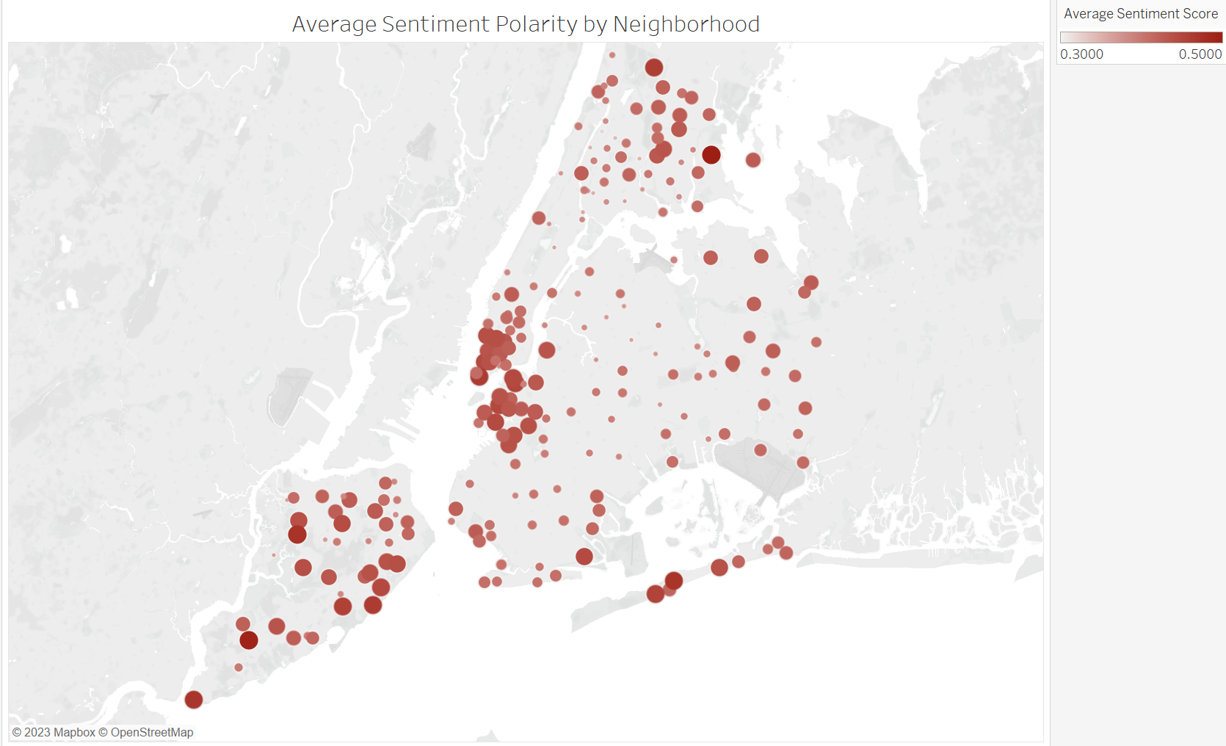
5/20
Notes:
title:
Average Sentiment Polarity by Neighborhood
format: centered

Slide 6
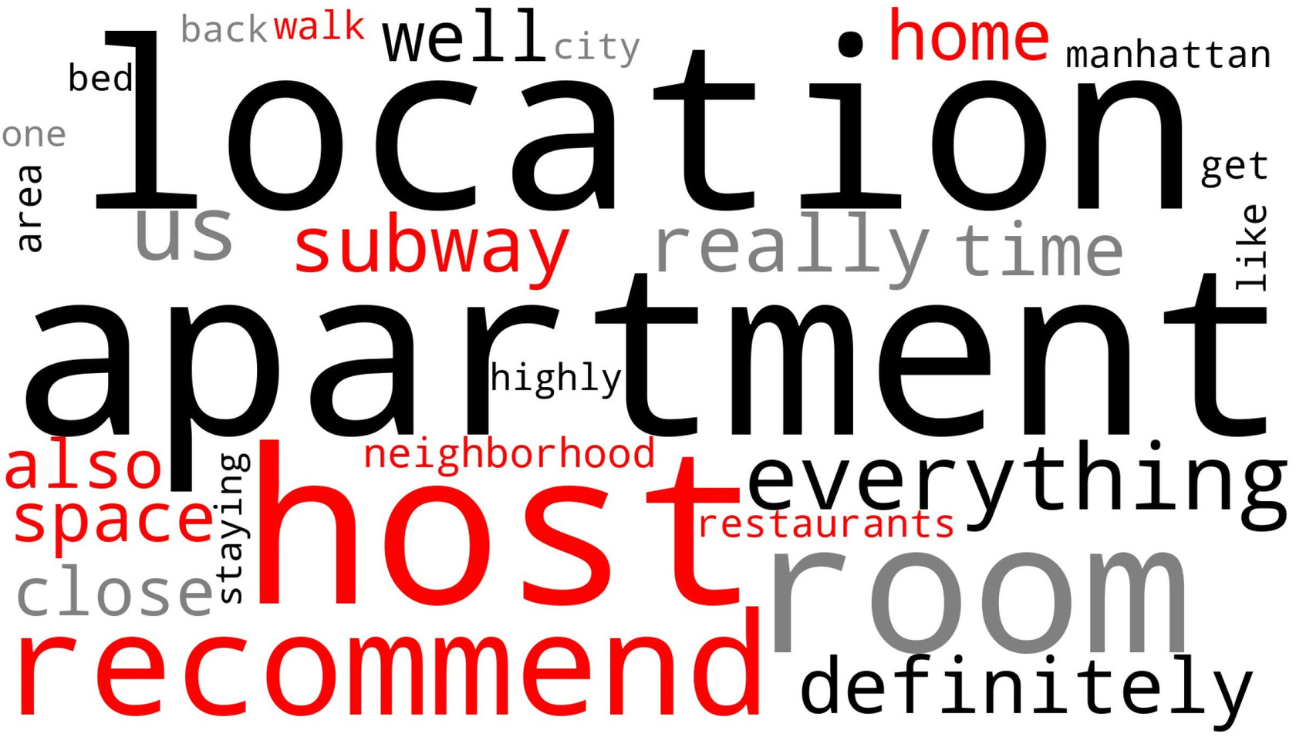
Most Frequent Keywords in Reviews
6/20
Notes:
title:
Word Cloud of Accommodation Review
format:
centered

Slide 7
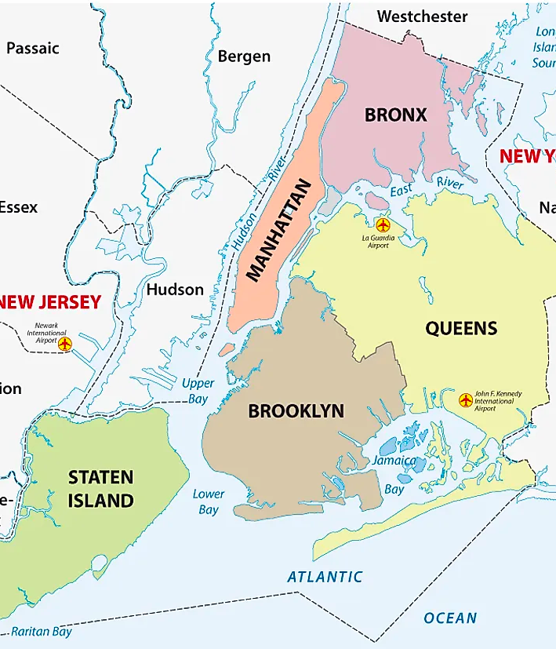
The Top 3 Neighborhoods for Investment
Flatiron
Chelsea
Murray Hills
8/20

Slide 8
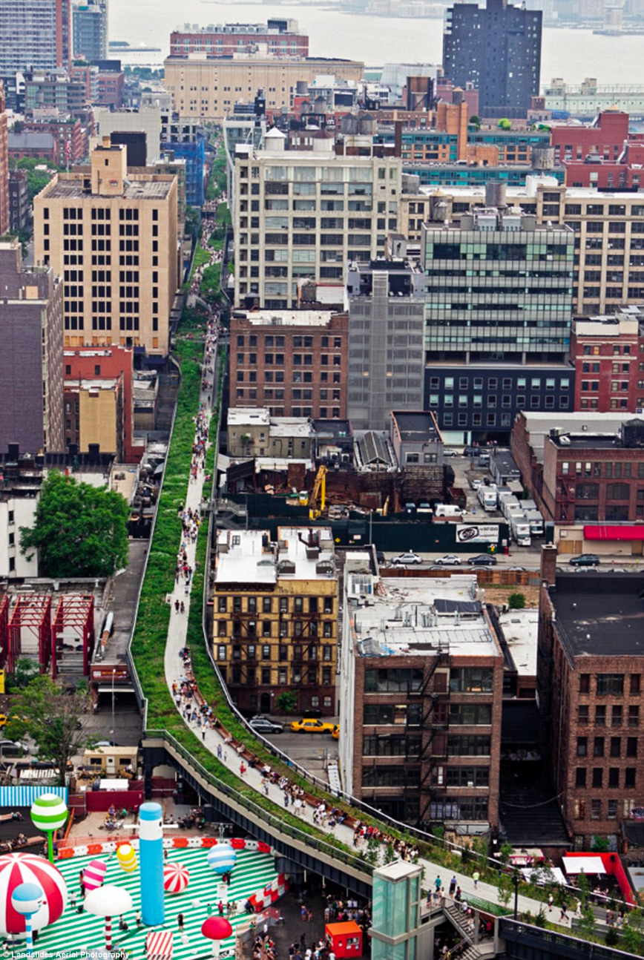
Chelsea
Near transportation and tourist attractions such as High-Line and Chelsea Market
Convenient access to arts and cultures, and diverse dining options
Trendy atmosphere
Active community with events and associations
Attracts younger, creative crowds
9/20
Notes:
Proximity to major transportation hubs (Penn Station, Port Authority Bus Terminal)
Strong demand for short-term rentals due to tourist attractions (Chelsea Piers, Whitney Museum of American Art, Chelsea Flea Market)
High potential for rental income with higher rental rates compared to other neighborhoods
Close proximity to major employment centers (Financial District, Midtown Manhattan, Hudson Yards)
Thriving arts and cultural scene with numerous art galleries, theaters, and cultural institutions
Access to a wide range of dining options catering to diverse culinary preferences
Well-connected community with active neighborhood associations and community events
Strong potential for positive reviews and ratings on short-term rental platform due to unique features, cultural attractions, and vibrant atmosphere.

Slide 9

Flatiron
Known for its central location
Unique and recognizable location
Diverse amenities and historic appeal
Excellent transportation options
10/20

Slide 10

Murray Hills
Diverse housing options in a residential setting with city amenities
Established neighborhood with proximity to Grand, Central Station, Empire State Building, Times Square, Fifth Avenue
Lively night life
11/20
Notes:
Prime location: Located in Midtown Manhattan with proximity to Grand Central Terminal
Diverse housing options: Offers apartment co-ops and townhouses for different preferences and budgets
Residential feel with city amenities: Tree-lined streets and mix of old and new buildings, with easy access to city amenities
Family-friendly environment: Mix of young professionals and families, highlighting nearby schools
Strong rental market: Consistent demand for short-term rentals due to central location and accessibility
Proximity to major attractions: Close to Empire State Building, Times Square, and Fifth Avenue, attracting tourists and business travelers
Established neighborhood: Well-established with a rich history and strong sense of community

Slide 11
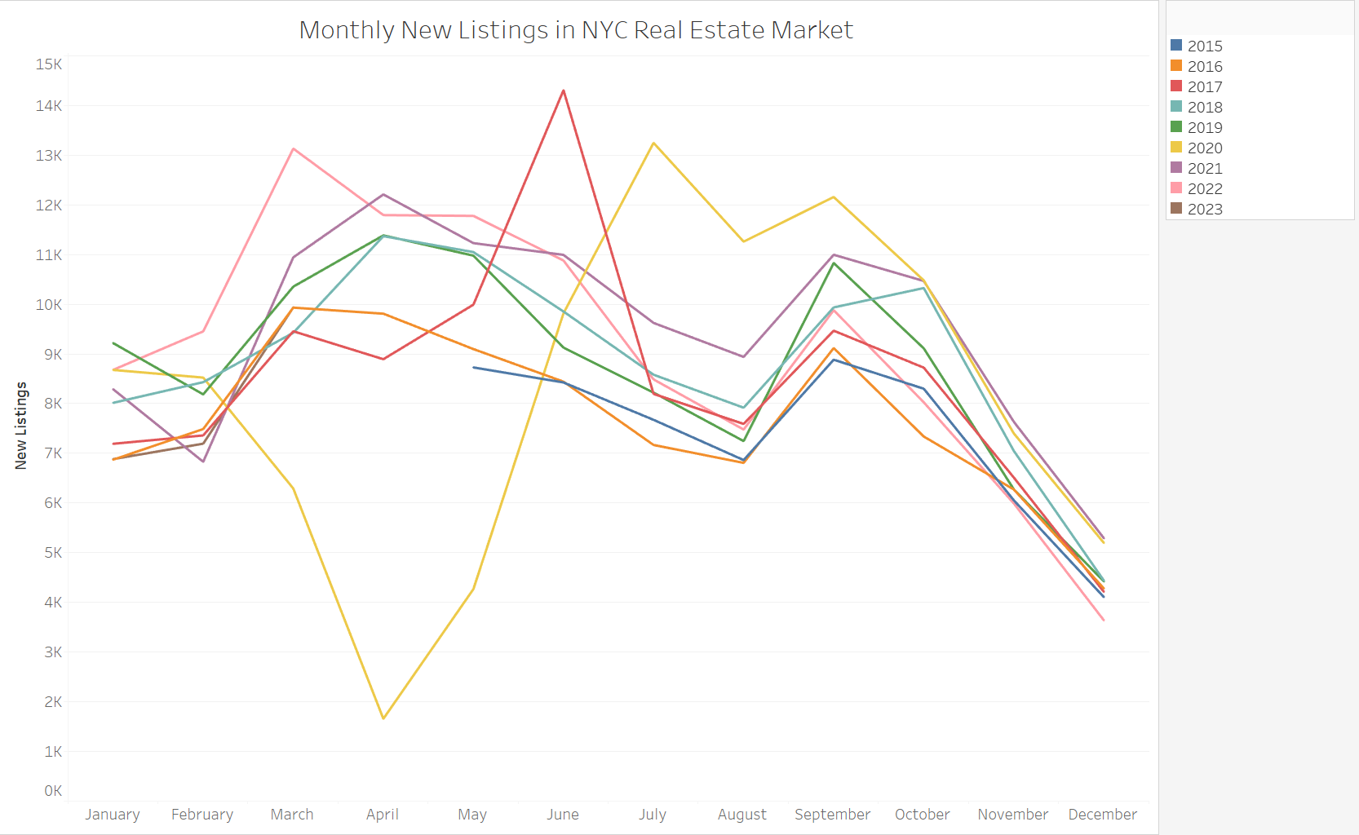
7/20

Slide 12



Investment Strategy
Buy-in timing:
April ~ June
Payment:
Installments
Flatiron:
2 Condos (1 bedroom)
Chelsea:
4 Apartments (2 bedrooms)
Murray Hill:
4 Apartments (2 bedrooms)
Funding Down Payment
Operational Cost
Total Capital Requirement
$2.28M
$0.5M
$2.78M
12/20

Slide 13
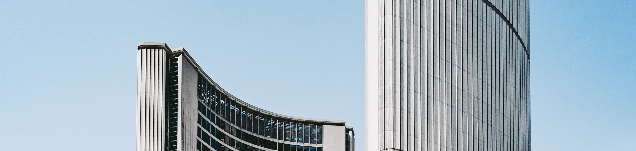
Revenue Projections
$1,037,860
$1,255,811
2024
2025
2026
2027
2028
$943,509
$1,141,646
$1,381,392
13/20

Slide 14

Recoupment Plan
 | FY '24 | FY '28 | YOY change
Revenue | $ 943,509 | $ 1,422,833 | % 10
Expenses | $ 573,029 | $ 723,544 | % 4
NOI | $ 629,360 | $ 946,012 | %10.6
14/20

Slide 15

Financial Metrics
Return rate - with Cashing out
147%
Share - without Cashing out
30%
Annual Revenue Growth Rate:
10 % (first five years)
3 % (after the fifth year)
15/20

Slide 16


Financial Metrics
Net present value in 5 years:
Break Even Point
$ 48,474,235
5 Years
Average Revenue/Property:
Payback Period - with Cashing Out
$ 94K
5 Years
Payback Period - without Cashing Out
21 Years
15/20

Slide 17
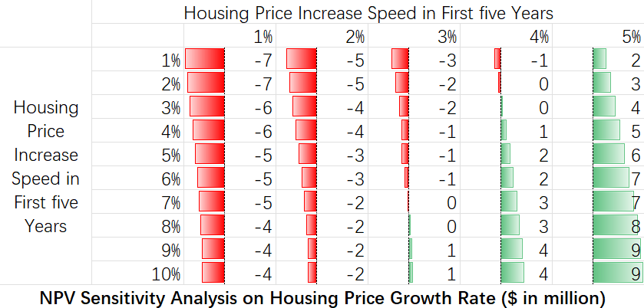

Slide 18



Technology Solutions
15/20

Slide 19



Third-Party Property Management Software
Early market
entry benefits
Advantages
Scalability
Up-to-date technology
Access to industry expertise
Time and cost savings
Penetrate NYC rental market sooner
High-demand
NYC rental market remains strong
Long-term growth potential
Diverse renters pool

Slide 20


Smart booking
Online-booking
Platforms
Technology
Contactless check-in and check-out
Keyless entry system
Airbnb
VRBO
Booking.com

Slide 21

Conclusion
Chelsea
5 year plan
Average Revenue per Property
Flatiron
Third-party rental platforms to rent units out.
Use prices of properties of similar features as the guideline of pricing.
Depending on the economy status
cash out after the fifth year, and pay back our investors an estimated amount of 4.12 million.
continue our renting business, which is of healthy cash flow, and give our investors 30% share of our company.
Technology Solutions
4 apartments (2b)
$ 94K
Murray Hills
Third-party property management software
Contactless check-in and check out through applications
Keyless entry system
Listing through Airbnb, VRBO, and Booking.com
2 condos (1b)
Capital Requirement
4 apartments (2b)
$3M

